Slide 1


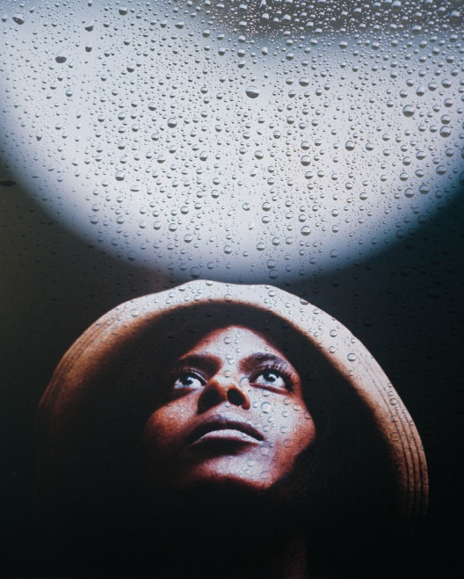
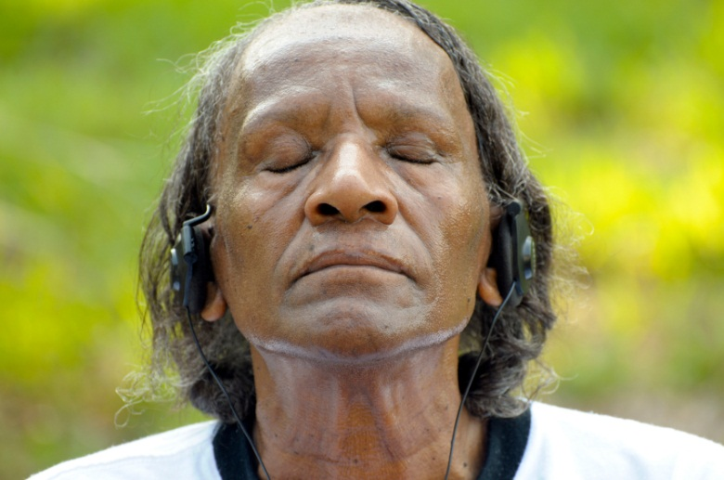
BTT Learning Unit Design
4th grade Spirituals Unit
Katie Cole
April 2012
JHU MBT

Slide 2



A Unit on Spirituals
4th grade unit that will last approximately 3-4 weeks
Based on Maryland Essential Learner Outcomes for the Fine Arts, National Association for Music Educators (NAfME) National Music Standards for Music Education, and Carroll County Public Schools’ Music Curriculum

Slide 3
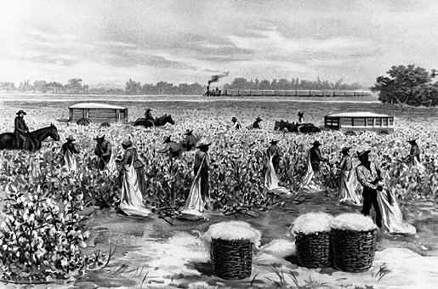
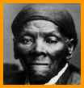
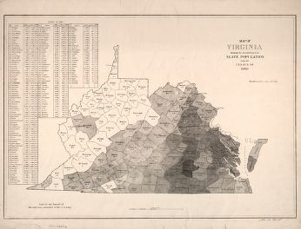
Brain Target 1: Setting the Emotional Climate for Learning
To prepare for our spirituals unit, students will need to understand the historical background of the time when African Americans were slaves. As a class, we will define “what is a slave?” and answer “How would it feel to be a slave?” Extension: Students can define what modern slavery could look like and what laws we need to have in place in order to avoid it.

Slide 4
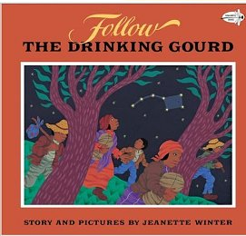
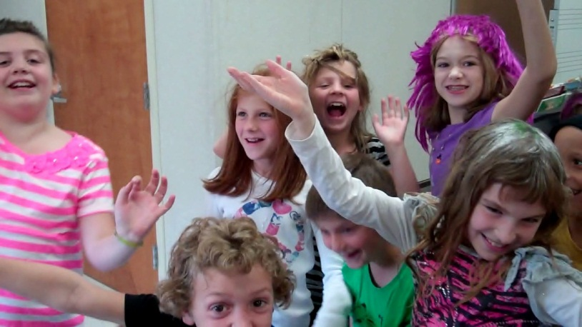
BT 1: Setting the Emotional Climate
To create an emotional connection, we will read the book, Follow the Drinking Gourd by Jeanette Winter; then, students will be given scripts and will act out a scenario that involves the Underground Railroad. Extension: students can make their own scripts to act out. During their dramatic presentation, they can use props such as sacks, aprons, etc.

Slide 5
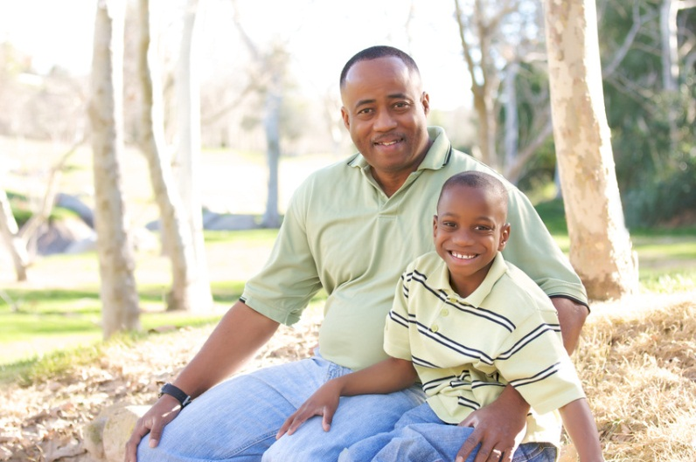
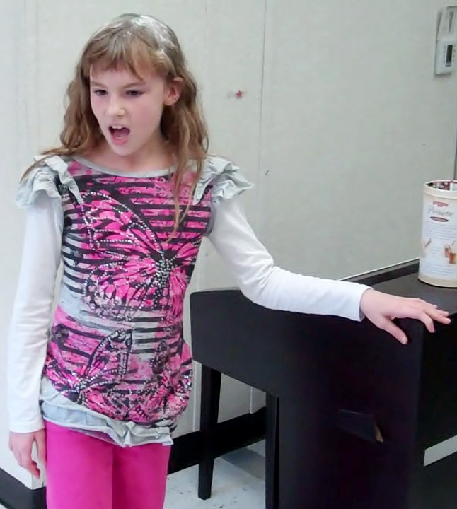

BT 1: Setting the Emotional Climate
To establish a personal connection, students will learn that spirituals have been passed down from generation to generation. They can explore any family songs that had been passed down to them from their parents or grandparents, etc. We can compile a virtual songbook by using a Flip camera to record students performing these songs and then saving them to a DVD.

Slide 6
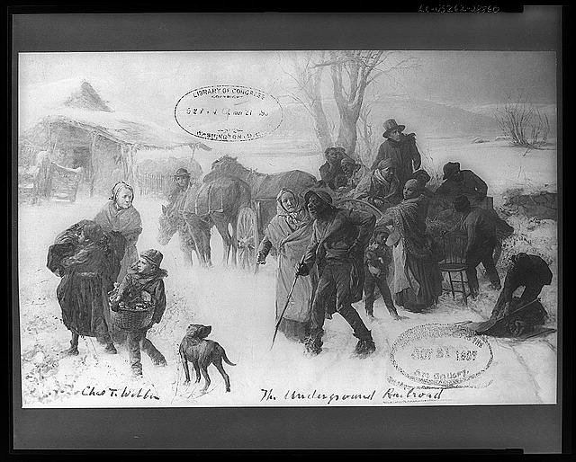
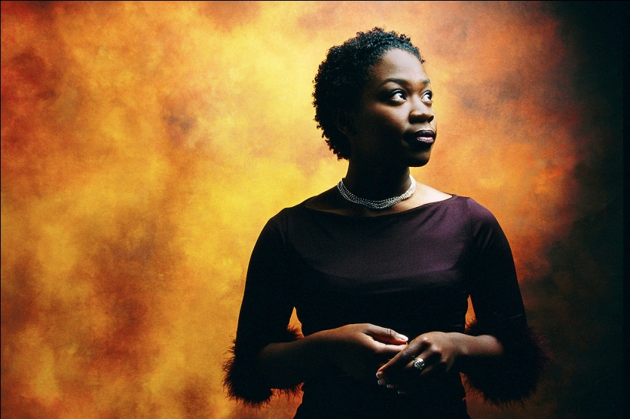
Brain Target 2: Creating the Physical Learning Environment
Pictures of Harriet Tubman and the representations of the Underground Railroad will be displayed on the walls
Pictures of the students acting out the Underground Railroad skits will be displayed on the bulletin board
African American art will be displayed throughout the room.

Slide 7
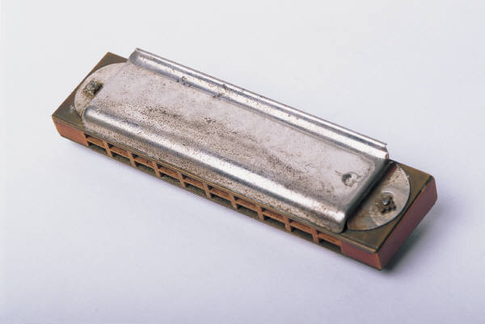


Brain Target 3: Designing the Learning Experience
Learning Goal: Students will demonstrate an understanding of spirituals as an essential aspect of African American history and human experience.
Student KWL Chart, then Class Concept Map: What are the main characteristics of spirituals (both textually and musically) and what role did they play in the lives of African American slaves?

Slide 8

Brain Target 4: Teaching for Mastery
Objective 1: Students will demonstrate an understanding of some spirituals as “signal songs.”
Activity 1a: Students will discuss the text of “Follow the Drinking Gourd” to discover the code words and their meanings and will sing the song as a class.

Slide 9
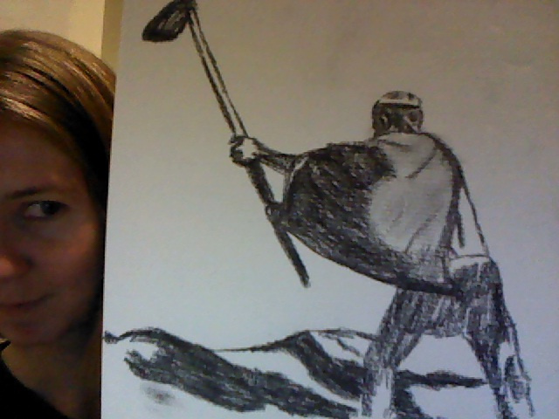

BT 4: Teaching for Mastery
Activity 1b: After exposing the students to recordings of several gospel groups singing spirituals, they will have a chance to reflect upon what they heard. In groups, students can choose to choreograph their favorite spiritual or to individually make an illustration of their favorite spiritual.

Slide 10
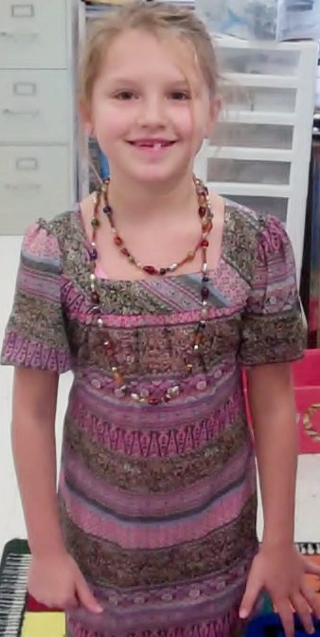
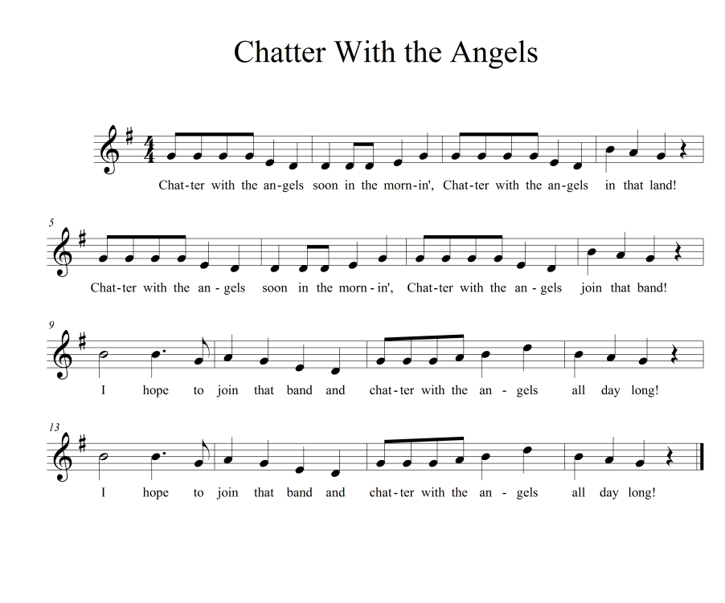
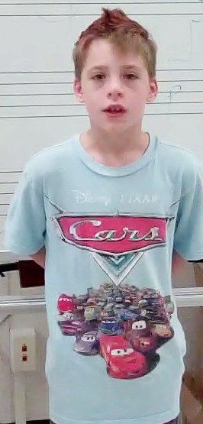
BT 4: Teaching for Mastery
Objective 2: Students will learn and perform African American spirituals to discover their musical structure of call-and-response form and verse and refrain form.

Slide 11
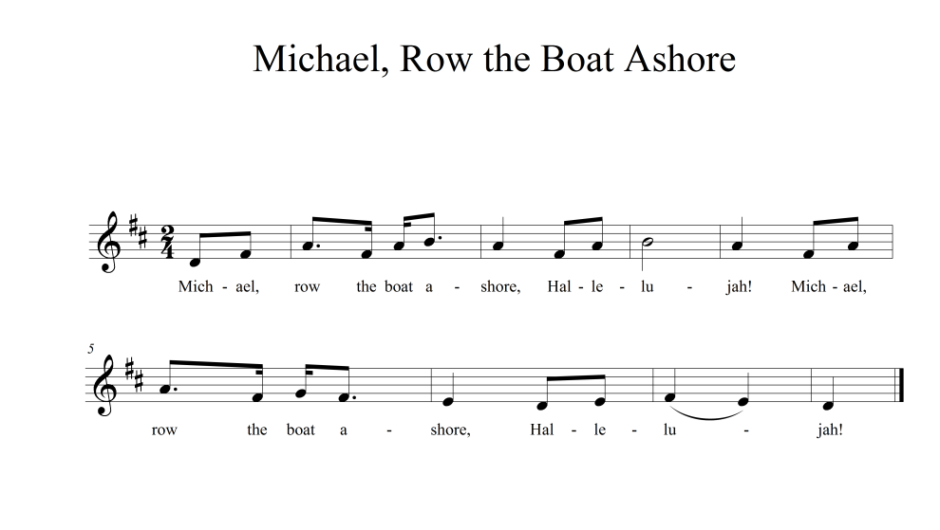
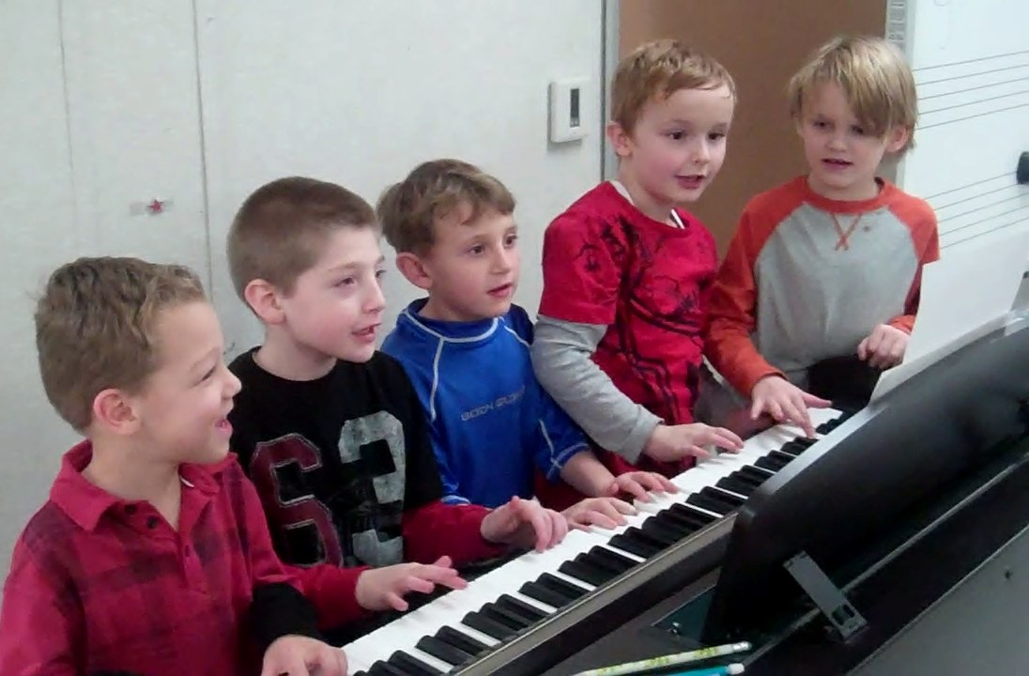
BT 4: Teaching for Mastery
Activity 2a: Students will discover “the call” and “the response” of “Swing Low” (I will sing the call and they will sing the response, and vice versa.) Students will also discover the call and response parts of other known spirituals, such as “Michael Row the Boat Ashore,” and “This Little Light of Mine.”

Slide 12
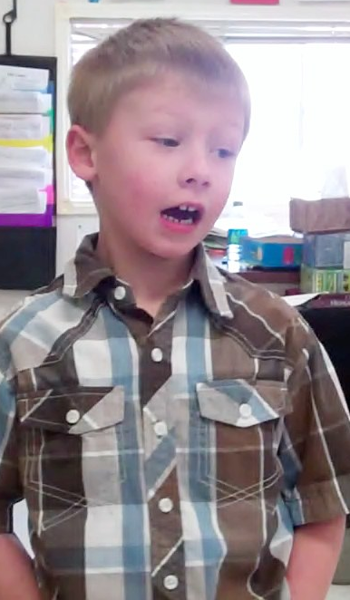
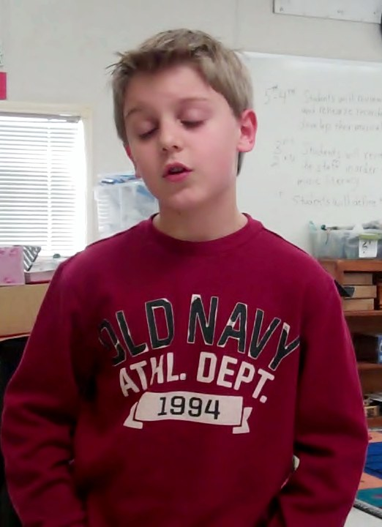
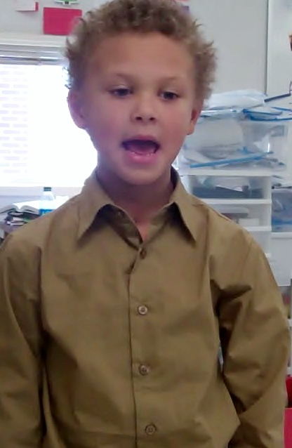
BT 4: Teaching for Mastery
Activity 2b: Students will discover the verse and refrain form of “Chatter with the Angels” by singing the song and then labeling the verse “A” and the refrain “B”. They will also discover the verse and refrain form (or AB form) of other known spirituals, such as “When the Saints Go Marchin’ In” and “Free At Last.”

Slide 13
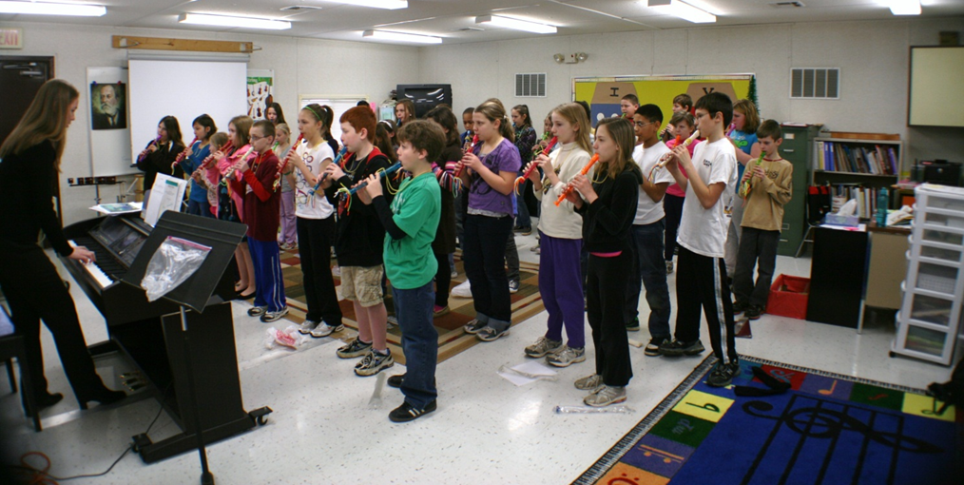
BT 4: Teaching for Mastery
Activity 2c: After singing spirituals with call-and-response and verse/refrain forms, students will perform these spirituals on their recorders.

Slide 14
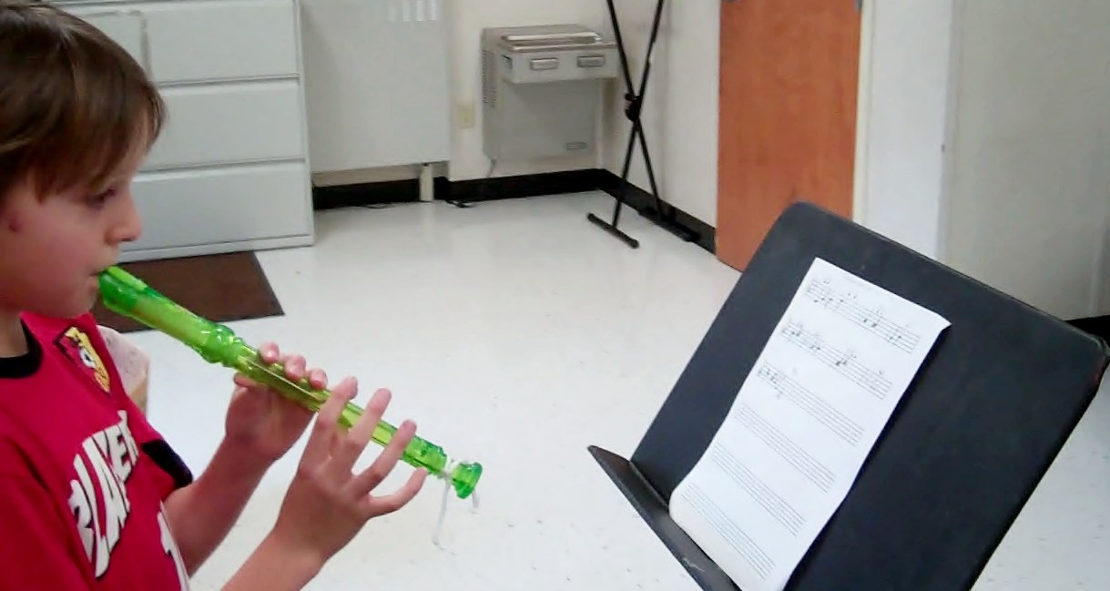

Brain Target 5: Teaching for Extension and Application of Knowledge
Learning Goal: Students will apply their knowledge of spirituals by composing their own.

Slide 15
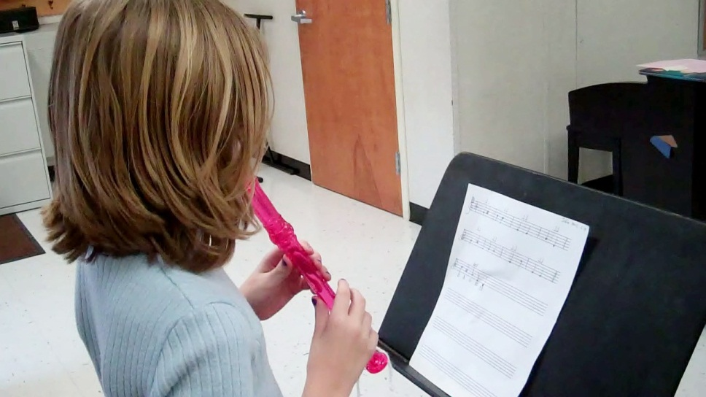
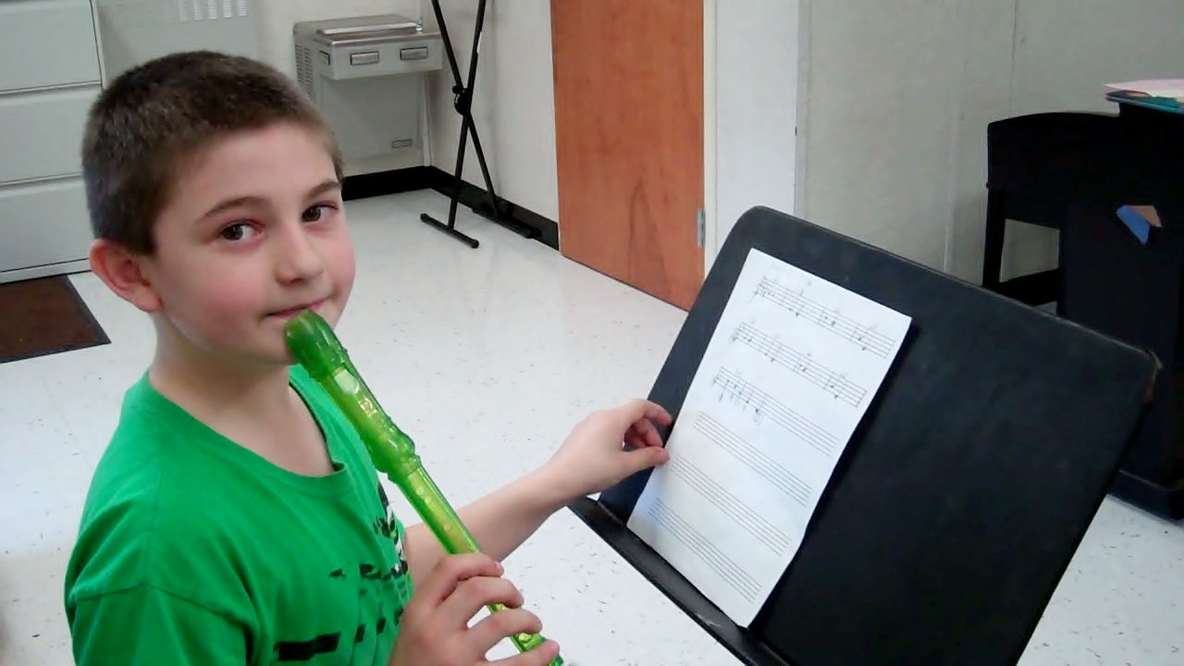
BT 5: Teaching for Extension and Application
Objective: Through composing their own spirituals, students will demonstrate the ability to organize musical ideas and sounds creatively.

Slide 16
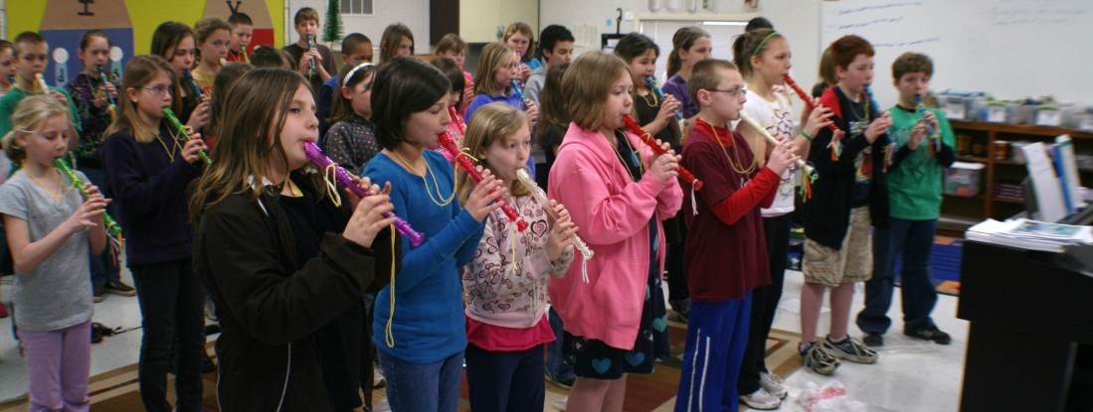
BT 5: Teaching for Extension and Application
Activity: Students can compose an aural or a notated spiritual for their recorders or for their voice. Students can choose to write a spiritual in either call-and-response form or in verse/refrain form. They will have time in class as well as at home to complete this project. Worksheets with compositional parameters (minimum of 16 measures in G Major) will be given to students to serve as a guide. Students will also be given blank staff paper and a link to free online staff paper at www.blanksheetmusic.net

Slide 17
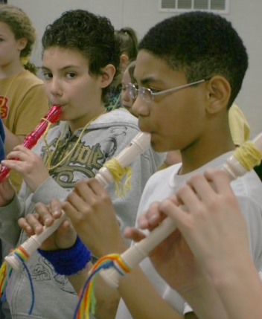
BT 5: Teaching for Extension and Application
In order to facilitate the composing process, students will be given a list of online resources:
  University of Denver’s “Sweet Chariot: The Story of Spirituals”
  http://ctl.du.edu/spirituals/History/index.cfm
  PBS’s “Jubilee Singers: Sacrifice and Glory” http://www.pbs.org/wgbh/amex/singers/index.html
  PBS’s “This Far by Faith: African American Spiritual Journeys” http://www.pbs.org/thisfarbyfaith/
  Authentic History’s “African American Spirituals” http://www.authentichistory.com/1600-1859/3-spirituals/index.html

Slide 18
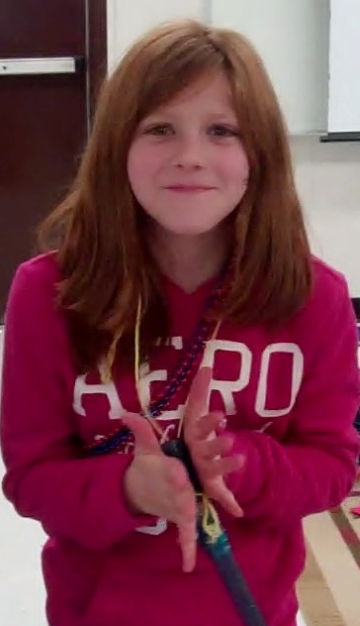
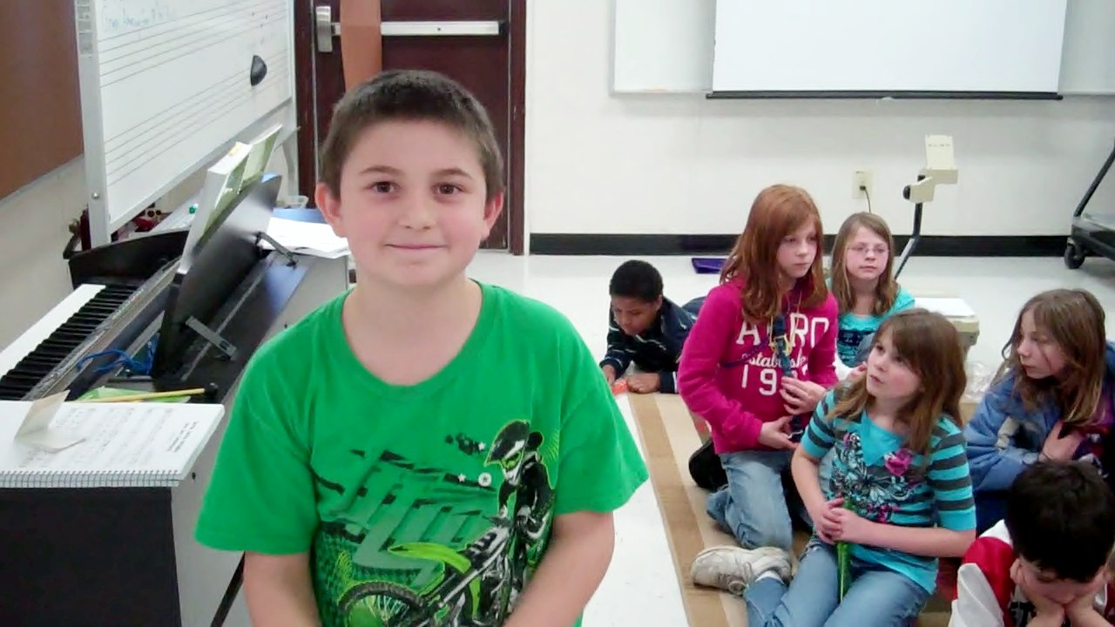
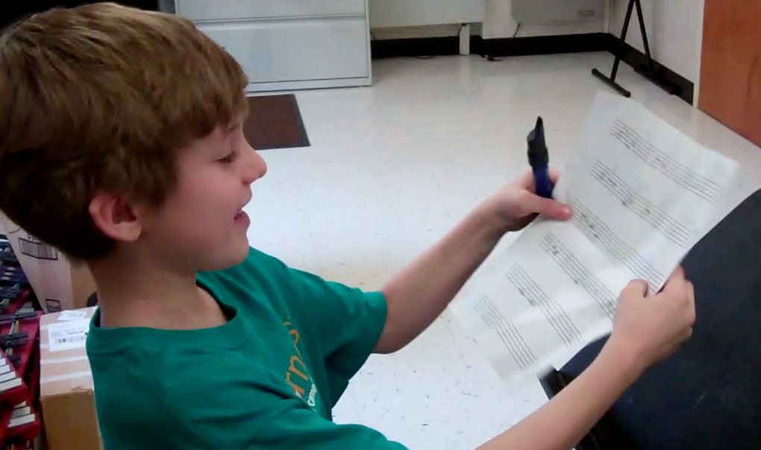
Brain Target 6: Evaluating Learning
Students will evaluate their learning by:
  Referring to a compositional rubric
  Receiving feedback on their in-class performances on voice and recorders
  Receiving feedback on the effectiveness of their Underground Railroad skits as based on a rubric and on positive evaluation by their peers
  Referring to a rubric for their drawings or choreography of their favorite spiritual

